Slide 1

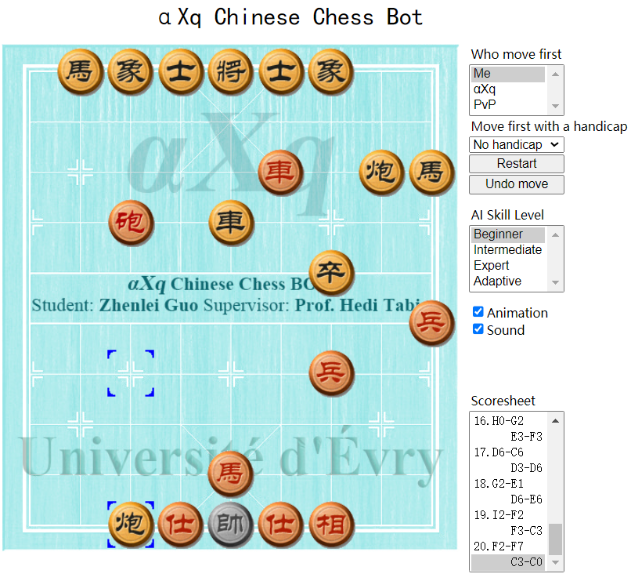
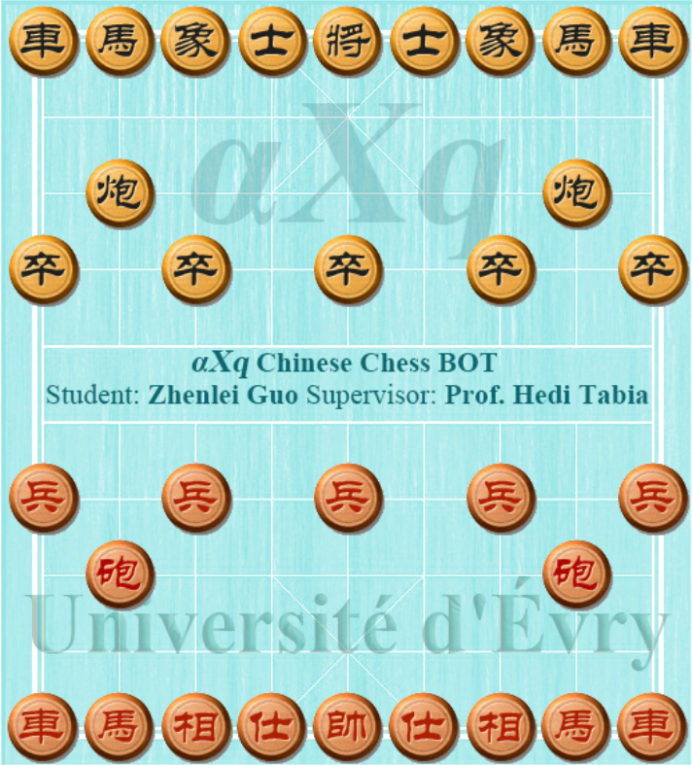
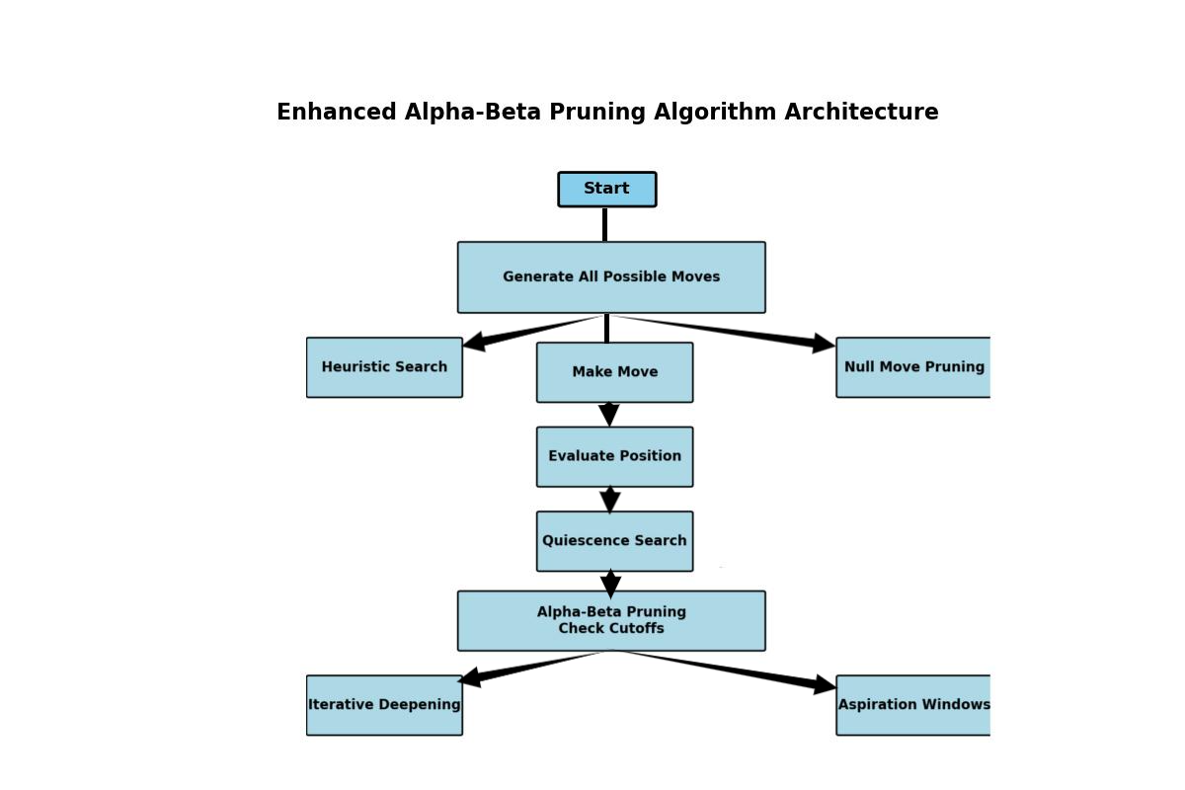
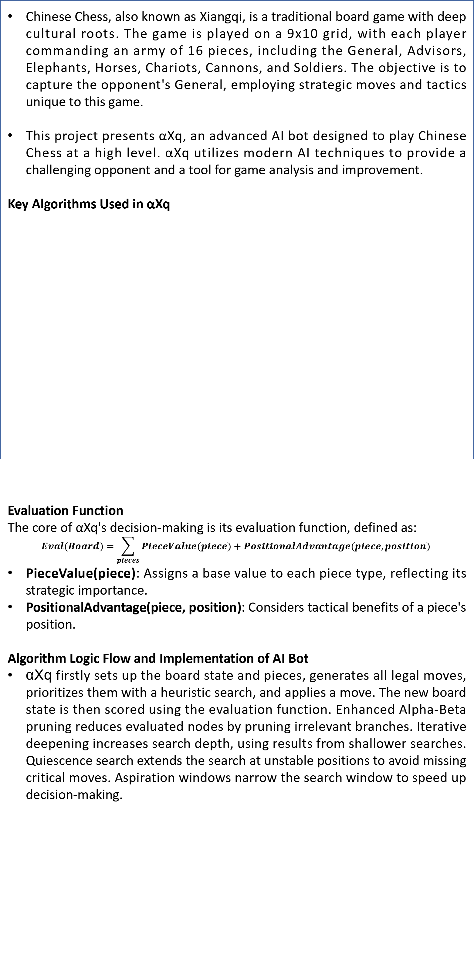
M1E3A: International Track In Electrical Engineering
αXq: An adaptive AI Bot for Chinese Chess Using Enhanced Pruning and Heuristic Algorithms
Student: Zhenlei Guo; Supervisor: Prof. Hedi Tabia
Université Paris-Saclay
Abstract
Results
The project develops an Chinese Chess bot with dynamic difficulty adjustment. It employs enhanced alpha-beta pruning, heuristic search, and quiescence search to optimize move selection and game strategy.
αXq adapts its difficulty based on the player's moves, providing a tailored challenge from beginner to expert levels. Key features include an opening book for early-game optimization, animated moves, sound effects, and undo/restart functionality.
The game resulted in a loss for the player, as shown in figure 2. αXq successfully outmaneuvered the player, leading to a defeat.
Thinking Time by AI Level
Beginner: 10 milliseconds
Intermediate: 100 milliseconds
Expert: 1000 milliseconds
Adaptive: Varies with the number of moves (10, 30, 100, 300, 1000 milliseconds)
Distribution of Total Moves
Beginner: Around 75-95 moves
Intermediate: Around 32-50 moves
Expert: Around 18-30 moves
Adaptive: Around 42-60 moves
Introduction
Chinese Chess, also known as Xiangqi, is a traditional board game with deep cultural roots. The game is played on a 9x10 grid, with each player commanding an army of 16 pieces, including the General, Advisors, Elephants, Horses, Chariots, Cannons, and Soldiers. The objective is to capture the opponent's General, employing strategic moves and tactics unique to this game.
This project presents αXq, an advanced AI bot designed to play Chinese Chess at a high level. αXq utilizes modern AI techniques to provide a challenging opponent and a tool for game analysis and improvement.
Key Algorithms Used in αXq
Evaluation Function
The core of αXq's decision-making is its evaluation function, defined as:
$$Eval(Board)=\sum_{pieces}{PieceValue(piece)}+PositionalAdvantage(piece,position)$$
PieceValue(piece): Assigns a base value to each piece type, reflecting its strategic importance.
PositionalAdvantage(piece, position): Considers tactical benefits of a piece's position.
Algorithm Logic Flow and Implementation of AI Bot
αXq firstly sets up the board state and pieces, generates all legal moves, prioritizes them with a heuristic search, and applies a move. The new board state is then scored using the evaluation function. Enhanced Alpha-Beta pruning reduces evaluated nodes by pruning irrelevant branches. Iterative deepening increases search depth, using results from shallower searches. Quiescence search extends the search at unstable positions to avoid missing critical moves. Aspiration windows narrow the search window to speed up decision-making.
Figure 3. αXq defeat human.
1. Enhanced Alpha-Beta Pruning: Reduces the number of positions evaluated.
2. Heuristic Search: Prioritizes strategic moves, enhancing decision-making efficiency.
3. Iterative Deepening: Increases search depth gradually to find optimal moves within time constraints.
4. Quiescence Search: Extends search in volatile positions.
5. Aspiration Windows: Narrows the search window to speed up decision-making.
Chart 1. Thinking Time By Chinese Chess AI Level.
Figure 1. αXq Chinese Chess Bot.
Method
Chart 2. Distribution of Total Moves in Games for Different AI Levels.
Discussion
The data shows that higher-level AIs not only think longer but also win more efficiently, resulting in fewer total moves. The adaptive AI adjusts its strategy based on the game's progress, providing a balanced challenge. The total number of moves reflects the time it takes for the AI to secure a win; longer games indicate less optimized strategies. In summary, higher-level AIs take longer to think but require fewer moves to win against humans.
After evaluating all moves, αXq selects the highest-scoring one. Dynamic difficulty adjustment tweaks search depth and evaluation based on the player's skill. αXq represents the board state and move sequences using arrays and trees, integrating search algorithms and evaluation functions.
Conclusions
This project implemented adaptive difficulty adjustment using an enhanced pruning algorithm for a Chinese Chess AI. The AI dynamically adjusts its difficulty based on the number of moves, resulting in a balanced challenge. The adaptive AI successfully balanced strategic depth and responsiveness.
Figure 2. Enhanced Alpha-Beta Pruning Architecture.
References
Fujita, K. (2021). AlphaDDA: Strategies for Adjusting the Playing Strength of a Fully Trained AlphaZero System to a Suitable Human Training Partner. ArXiv. /abs/2111.06266
M. Zhai, L. Chen, F. Tung, J. He, M. Nawhal and G. Mori, "Lifelong GAN: Continual Learning for Conditional Image Generation," 2019 IEEE/CVF International Conference on Computer Vision (ICCV), Seoul, Korea (South), 2019, pp. 2759-2768, doi: 10.1109/ICCV.2019.00285.
Andrade, G., Ramalho, G., Corruble, V.: Challenge-sensitive action selection: an application to game balancing. In: WIC 2005, Compiegne, France, pp. 194–200. IEEE (2005)
Silver, D., Hubert, T., Schrittwieser, J., Antonoglou, I., Lai, M., Guez, A., Lanctot, M., Sifre, L., Kumaran, D., Graepel, T., Lillicrap, T., Simonyan, K., & Hassabis, D. (2017). Mastering Chess and Shogi by Self-Play with a General Reinforcement Learning Algorithm. ArXiv. /abs/1712.01815
Hunicke, R., Chapman, V.: AI for dynamic difficulty adjustment in games. In: AAAI 2004, San Jose, CA, USA, pp. 91–96. AAAI Press (2004)

